Slide 1
UNIT-1
PROBABILITY and RANDOM VARIABLE

Slide 2
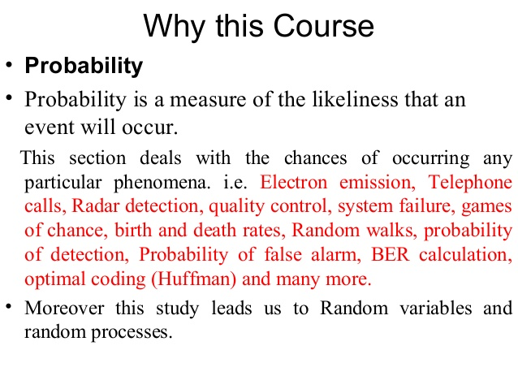

Slide 3
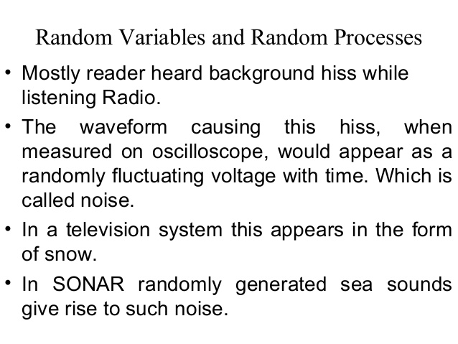

Slide 4
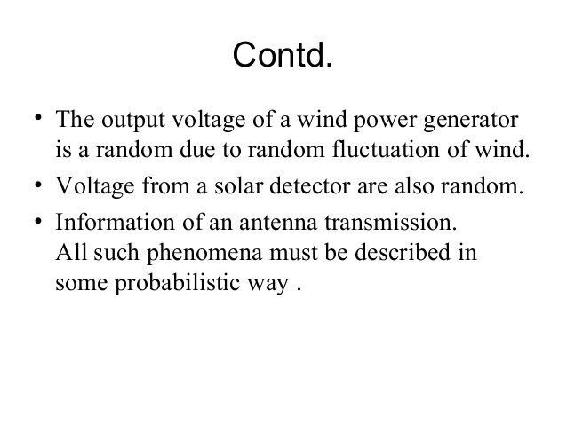

Slide 5
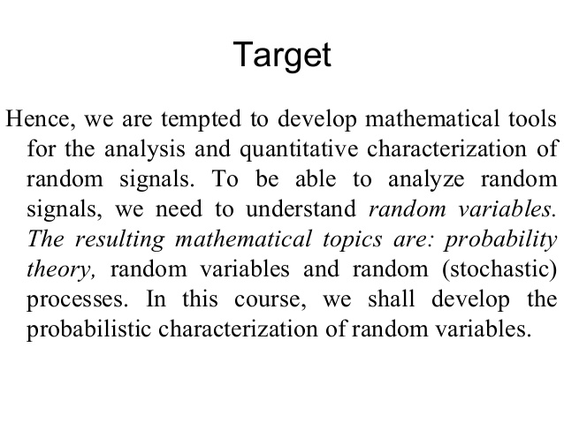

Slide 6
THE BASIC CONCEPTS OF SET THEORY
Set: A set is a well defined collection of objects.
These objects are called elements or members of the set.
Sets are usually denoted by capital letters A, B, C, ....., etc.
Elements of the set are represented by small letters a, b, c, ....., etc.
If a is an element of set A, then we say that a belongs to A. We denote the ‘phrase belongs to‘ by the Greek symbol ∈ (epsilon). Thus, we say that a ∈ A.
If b is an element which does not belong to A, we represent this as b ∉ A

Slide 7
1. Empty Set or Null Set:
A set which does not contain any element is called an empty set, or the null set or the void set and it is denoted by ∅ and is read as phi. In roster form, ∅ is denoted An empty set is a finite set, since the number of elements in an empty set is finite, i.e., 0. by {}.
For example: (a) the set of whole numbers less than 0. (b) N = {x : x ∈ N, 3 < x < 4}
• Let A = {x : 2 < x < 3, x is a natural number}
Here A is an empty set because there is no natural number between 2 and 3.
Tabularly specified A={1,2,3,4}
Rule specified

Slide 8
2. Finite Set:
A set which contains a definite number of elements is called a finite set. Empty set is also called a finite set.
For example:
• The set of all colors in the rainbow.
• N = {x : x ∈ N, x < 7}
• P = {2, 3, 5, 7, 11, 13, 17, ...... 97}
3. Infinite Set:
The set whose elements cannot be listed, i.e., set containing never-ending elements is called an infinite set.
For example:
• Set of all points in a plane

Slide 9
4. Cardinal Number of a Set:
The number of distinct elements in a given set A is called the cardinal number of A. It is denoted by n(A). And read as ̳the number of elements of the set‘.
A = {1, 2, 3, 4}
Therefore, n(A) = 4
• B = set of letters in the word ALGEBRA
B = {A, L, G, E, B, R}
Therefore, n(B) = 6
5. Equivalent Sets:
Two sets A and B are said to be equivalent if their cardinal number is same, i.e., n(A) =n(B). The symbol for denoting an equivalent set is ̳↔‘.
A = {1, 2, 3} Here n(A) = 3
B = {p, q, r} Here n(B) = 3
Therefore, A ↔ B

Slide 10
6. Equal sets:
Two sets A and B are said to be equal if they contain the same elements. Every element of A is an element of B and every element of B is an element of A.
For example:
A = {p, q, r, s}
B = {p, s, r, q}
Therefore, A = B
7. Disjoint Sets:
Two sets A and B are said to be disjoint, if they do not have any element in common.

Slide 11
8. Definition of Subset:
If A and B are two sets, and every element of set A is also an element of set B, then A is called a subset of B and we write it as A ⊆ B or B ⊇ A
9. Proper Subset:
If A and B are two sets, then A is called the proper subset of B if A ⊆ B but B ⊇ A i.e., A ≠ B. The symbol ̳⊂‘ is used to denote proper subset. Symbolically, we write A ⊂ B.
Null set or ∅ is a proper subset of every
10. Super Set:
Whenever a set A is a subset of set B, we say the B is a superset of A and we write, B ⊇ A.

Slide 12
Universal Set
A set which contains all the elements of other given sets is called a universal set. The symbol for denoting a universal set is ∪ or ξ.
1. If A = {1, 2, 3} B = {2, 3, 4} C = {3, 5, 7}
then U = {1, 2, 3, 4, 5, 7}
[Here A ⊆ U, B ⊆ U, C ⊆ U and U ⊇ A, U ⊇ B, U ⊇ C]

Slide 13
Examples
A={1,3,5,7}- finite, countable, tabular
B={1,2,3,……}- infinite, uncountable, tabular
C= {0.5≤c ≤8.5}-infinite, rule
D={0.0}- finite-one element ‘0.0’,countable
E={2,4,6,8,10,12,14}- finite, countable
F={-5.0 ≤f ≤12.0}-infinite
A is subset of B
A is subset of C
A is subset of F
C is subset of F

Slide 14
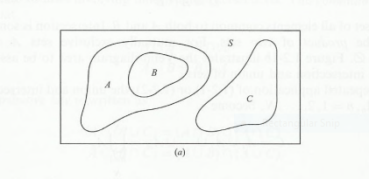
Here B is subset of A
A ,Band C are subsets of S
A and C are disjoint sets
B and C also disjoint sets
S is universal set

Slide 15
Examples of sets
1. Describe the set of vowels.
If A is the set of vowels, then A could be described as A = {a, e, i, o, u}.
2 Set A = {1, 2, 3} and Set B = {3, 2, 1}. Is Set A equal to Set B?
Yes. Two sets are equal if they have the same elements. The order in which the elements are listed does not matter.
3 What is the set of men with four arms?
Since all men have two arms at most, the set of men with four arms contains no elements.
It is the null set (or empty set).
4 Set A = {1, 2, 3} and Set B = {1, 2, 4, 5, 6}. Is Set A a subset of Set B?
Set A would be a subset of Set B if every element from Set A were also in Set B. However, this is not the case.
The number 3 is in Set A, but not in Set B. Therefore, Set A is not a subset of Set B

Slide 16
Operations on sets
1. Definition of Union of Sets:
To find the union of two given sets A and B is a set which consists of all the elements of A and all the elements of B such that no element is repeated.
The symbol for denoting union of sets is ̳∪‘.
Some properties of the operation of union:
(i) A∪B = B∪A (Commutative law)
(ii) A∪(B∪C) = (A∪B)∪C (Associative law)
(iii) A ∪ Ф = A (Law of identity element, is the identity of ∪)
iv) A∪A = A (Idempotent law)
(v) U∪A = U (Law of ∪) ∪ is the universal set.
Note A ∪ Ф = Ф∪ A = A i.e. union of any set with the empty set is always the set itself.

Slide 17
Examples:
1. If A = {1, 3, 7, 5} and B = {3, 7, 8, 9}. Find union of two set A and B.
A ∪ B = {1, 3, 5, 7, 8, 9} No element is repeated in the union of two sets. The common elements 3, 7 are taken only once.
Let X = {a, e, i, o, u} and Y = {ф}. Find union of two given sets X and Y.
X ∪ Y = {a, e, i, o, u}
Therefore, union of any set with an empty set is the set itself.
2. Definition of Intersection of Sets
To find the intersection of two given sets A and B is a set which consists of all the elements which are common to both A and B.
The symbol for denoting intersection of sets is ̳∩

Slide 18
Some properties of the operation of intersection
(i) A∩B = B∩A (Commutative law)
(ii) (A∩B)∩C = A∩ (B∩C) (Associative law)
(iii) Ф ∩ A = Ф (Law of Ф)
(iv) U∩A = A (Law of ∪)
(v) A∩A = A (Idempotent law)
(vi) A∩(B∪C) = (A∩B) ∪ (A∩C) (Distributive law) Here ∩ distributes over ∪
Also, A∪(B∩C) = (AUB) ∩ (AUC) (Distributive law) Here ∪ distributes over ∩
Notes:
A ∩ Ф = Ф ∩ A = Ф i.e. intersection of any set with the empty set is always the empty set

Slide 19
Examples:
1. If A = {2, 4, 6, 8, 10} and B = {1, 3, 8, 4, 6}. Find intersection of two set A and B
A ∩ B = {4, 6, 8}
If X = {a, b, c} and Y = {ф}. Find intersection of two given sets X and Y.
X ∩ Y = { }
3. Difference of two sets
If A and B are two sets, then their difference is given by A - B or B - A.
• If A = {2, 3, 4} and B = {7, 5, 6}
A - B means elements of A which are not the elements of B.
i.e., in the above example A - B = {2, 3}
If A and B are disjoint sets, then A – B = A and B – A = B

Slide 20
1. A = {1, 2, 3} and B = {4, 5, 6}. Find the difference between the two sets:
(i) A and B (ii) B and A
Solution:
The two sets are disjoint as they do not have any elements in common.
(i) A - B = {1, 2, 3} = A (ii) B - A = {4, 5, 6} = B
2. Let A = {a, b, c, d, e, f} and B = {b, d, f, g}.
Find the difference between the two sets:
(i) A and B (ii) B and A
Solution:
(i) A - B = {a, c, e} Therefore, the elements a, c, e belong to A but not to B
(ii) B - A = {g) Therefore, the element g belongs to B but not A

Slide 21
A= { 0.6 < a ≤ 1.6 }
B = {1.0 ≤ b ≤2.5 }
then A – B = { 0.6 < a <1.0 }
B – A = { 1.6 < b ≤2.5
A – B ≠ B – A

Slide 22
4. Complement of a Set
In complement of a set if S be the universal set and A a subset of S then the complement of A is the set of all elements of S which are not the elements of A.
Symbolically, we denote the complement of A with respect to S as A‘.
Some properties of complement sets
(i) A ∪ A' = A' ∪ A = ∪ (Complement law)
(ii) (A ∩ A') = φ (Complement law) - The set and its complement are disjoint sets.
(iii) (A ∪ B)' = A' ∩ B' (De Morgan‘s law)
(iv) (A ∩ B)' = A' ∪ B' (De Morgan‘s law)
(v) (A')' = A (Law of complementation)
(vi) Ф' = ∪ (Law of empty set - The complement of an empty set is a universal set.
(vii) ∪' = Ф and universal set) - The complement of a universal set is an empty set.

Slide 23
For Example; If S = {1, 2, 3, 4, 5, 6, 7} A = {1, 3, 7} find A'.
Solution:
We observe that 2, 4, 5, 6 are the only elements of S which do not belong to A.
Therefore, A' = {2, 4, 5, 6}

Slide 24
Algebraic laws on sets:
1. Commutative Laws:
For any two finite sets A and B
(i) A U B = B U A
(ii) A ∩ B = B ∩ A
2. Associative Laws:
For any three finite sets A, B and C;
(i) (A U B) U C = A U (B U C)
(ii) (A ∩ B) ∩ C = A ∩ (B ∩ C)
Thus, union and intersection are associative.

Slide 25
3. Idempotent Laws:
For any finite set A;
(i) A U A = A
(ii) A ∩ A = A
4. Distributive Laws:
For any three finite sets A, B and C;
(i) A U (B ∩ C) = (A U B) ∩ (A U C)
(ii) A ∩ (B U C) = (A ∩ B) U (A ∩ C)
Thus, union and intersection are distributive over intersection and union respectively

Slide 26
5. De Morgan’s Laws:
The complement of the union of two sets is equal to the intersection of their complements and the complement of the intersection of two sets is equal to the union of their complements. These are called De Morgan’s laws.
For any two finite sets A and B;
(i) A – (B U C) = (A – B) ∩ (A – C)
(ii) A - (B ∩ C) = (A – B) U (A – C)
De Morgan‘s Laws can also we written as:
For any two finite sets A and B;
(i) (A U B)' = A' ∩ B' (which is a De Morgan's law of union).
(ii) (A ∩ B)' = A' U B' (which is a De Morgan's law of intersection)

Slide 27
6. More laws of algebra of sets:
For any two finite sets A and B;
(i) A – B = A ∩ B' (ii) B – A = B ∩ A' (iii) A – B = A ⇔ A ∩ B = ∅
(iv) (A – B) U B = A U B (vi) (A – B) U (B – A) = (A U B) – (A ∩ B) (v) (A – B) ∩ B = ∅
(vi) (AUB)= A+ B - (A ∩B)
Venn Diagrams:
Pictorial representations of sets represented by closed figures are called set diagrams or Venn diagrams.
Venn diagrams are used to illustrate various operations like union, intersection and difference.

Slide 28
A={2<a≤16} A={3,4,…16}
B={5<b ≤22} B={6,7,…22}
S={2<s≤24} S= {3,4,…24}
Verify de morgan’s law
(i) (A ∩B)’=A’UB’ (ii) (A U B)' = A' ∩ B' law of union
C=(A ∩B)= {5<c ≤16}
C’=(A ∩B)’=S-(A ∩B)={2<c ≤5, 16<c ≤24}----(1)
A’=S-A={16<a ≤24}
B’=S-B={2<b ≤5,22<b ≤24}
A’UB’={2<c ≤5,16<c ≤24}----(2)

Slide 29
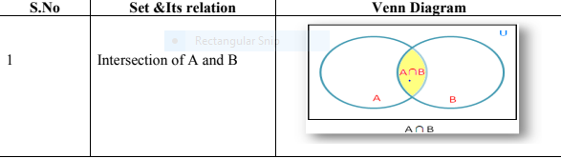
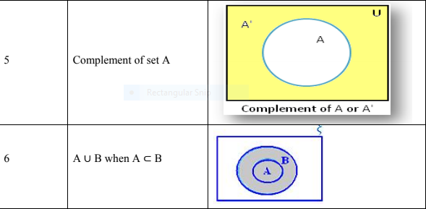
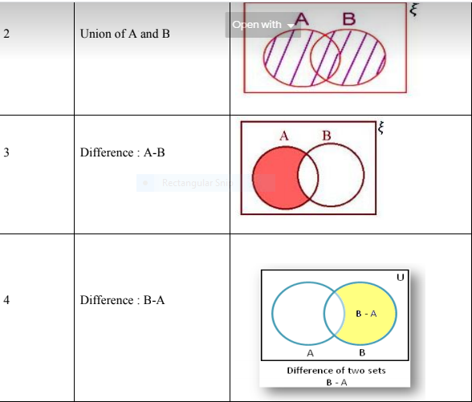
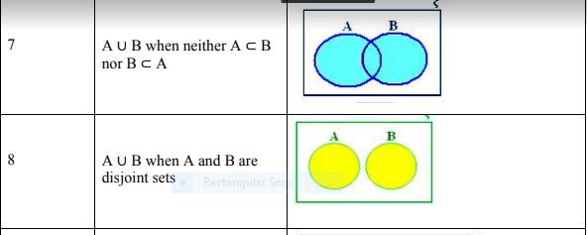

Slide 30
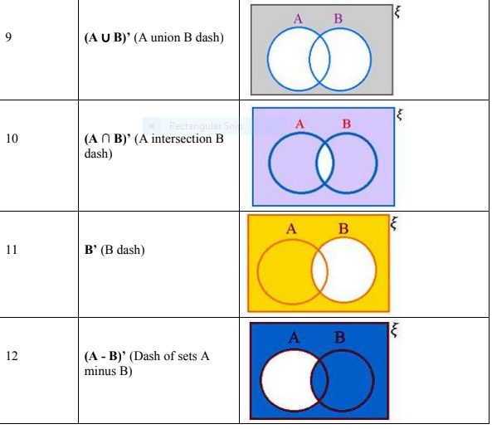

Slide 31
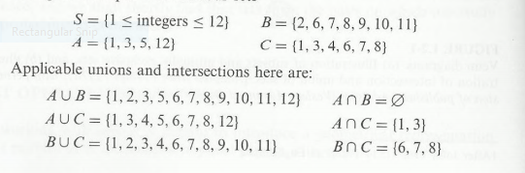
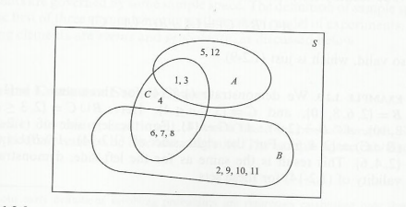
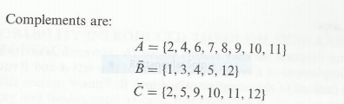

Slide 32
Problems of set theory:
1. Let A and B be two finite sets such that n(A) = 20, n(B) = 28 and n(A ∪ B) = 36, find n(A ∩ B).
Solution: Using the formula n(A ∪ B) = n(A) + n(B) - n(A ∩ B). then n(A ∩ B) = n(A) + n(B) - n(A ∪ B) = 20 + 28 - 36 = 48 - 36 = 12

Slide 33
2. If n(A - B) = 18, n(A ∪ B) = 70 and n(A ∩ B) = 25, then find n(B).
Solution: Using the formula n(A∪B) = n(A - B) + n(A ∩ B) + n(B - A) 70 = 18 + 25 + n(B - A) 70 = 43 + n(B - A) n(B - A) = 70 - 43 n(B - A) = 27 Now n(B) = n(A ∩ B) + n(B - A) = 25 + 27 = 52
Find n(A)= n(A-B)+ n(A ∩ B)

Slide 34
3. In a group of 60 people, 27 like cold drinks and 42 like hot drinks and each person likes at least one of the two drinks. How many like both?
Solution:
Let A = Set of people who like cold drinks.
B = Set of people who like hot drinks.
Given
(A ∪ B) = 60 n(A) = 27 n(B) = 42 then;
n(A ∩ B) = n(A) + n(B) - n(A ∪ B)
= 27 + 42 - 60
= 69 - 60 = 9
= 9
Therefore, 9 people like both tea and coffee.

Slide 35
5. In a group of 100 persons, 72 people can speak English and 43 can speak French. How many can speak English only? How many can speak French only and how many can speak both English and French?
Solution:
Let A be the set of people who speak English.
B be the set of people who speak French.
A - B be the set of people who speak English and not French.
B - A be the set of people who speak French and not English.
A ∩ B be the set of people who speak both French and English.
Given,
n(A) = 72 n(B) = 43 n(A ∪ B) = 100
Now, n(A ∩ B) = n(A) + n(B) - n(A ∪ B)
= 72 + 43 - 100 = 115 - 100 = 15
Therefore, Number of persons who speak both French and English = 15

Slide 36
n(A) = n(A - B) + n(A ∩ B) ⇒ n(A - B) = n(A) - n(A ∩ B)
= 72 - 15
= 57
and n(B - A) = n(B) - n(A ∩ B)
= 43 - 15
= 28
Therefore, Number of people speaking English only = 57
Number of people speaking French only = 28

Slide 37
6. In a competition, a school awarded medals in different categories. 36 medals in dance, 12 medals in dramatics and 18 medals in music. If these medals went to a total of 45 persons and only 4 persons got medals in all the three categories, how many received medals in exactly two of these categories?
Solution: Let A = set of persons who got medals in dance. B = set of persons who got medals in dramatics. C = set of persons who got medals in music. Given, n(A) = 36 n(B) = 12 n(C) = 18 n(A ∪ B ∪ C) = 45 n(A ∩ B ∩ C) = 4 We know that number of elements belonging to exactly two of the three sets A, B, C = n(A ∩ B) + n(B ∩ C) + n(A ∩ C) - 3n(A ∩ B ∩ C) = n(A ∩ B) + n(B ∩ C) + n(A ∩ C) - 3 × 4 ……..(i) n(A ∪ B ∪ C) = n(A) + n(B) + n(C) - n(A ∩ B) - n(B ∩ C) - n(A ∩ C) + n(A ∩ B ∩ C) Therefore, n(A ∩ B) + n(B ∩ C) + n(A ∩ C) = n(A) + n(B) + n(C) + n(A ∩ B ∩ C) - n(A ∪ B ∪ C) From (i) required number = n(A) + n(B) + n(C) + n(A ∩ B ∩ C) - n(A ∪ B ∪ C) - 12 = 36 + 12 + 18 + 4 - 45 - 12 = 70 – 57 = 13

Slide 38
Each student in a class of 40 plays at least one indoor game chess, carrom and scrabble. 18 play chess, 20 play scrabble and 27 play carrom. 7 play chess and scrabble, 12 play scrabble and carrom and 4 play chess, carrom and scrabble. Find the number of students who play (i) chess and carrom. (ii) chess, carrom but not scrabble.
Solution: Let A be the set of students who play chess B be the set of students who play scrabble C be the set of students who play carrom Therefore, We are given n(A ∪ B ∪ C) = 40, n(A) = 18, n(B) = 20 n(C) = 27, n(A ∩ B) = 7, n(C ∩ B) = 12 n(A ∩ B ∩ C) = 4 We have n(A ∪ B ∪ C) = n(A) + n(B) + n(C) - n(A ∩ B) - n(B ∩ C) - n(C ∩ A) + n(A ∩ B ∩ C) Therefore, 40 = 18 + 20 + 27 - 7 - 12 - n(C ∩ A) + 4 40 = 69 – 19 - n(C ∩ A) 40 = 50 - n(C ∩ A) n(C ∩ A) = 50 - 40 n(C ∩ A) = 10 Therefore, Number of students who play chess and carrom are 10. Also, number of students who play chess, carrom and not scrabble. = n(C ∩ A) - n(A ∩ B ∩ C) = 10 – 4 = 6

Slide 39
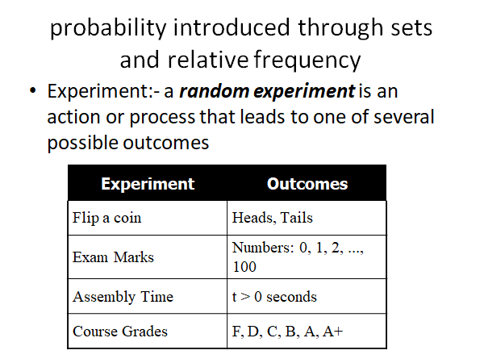

Slide 40
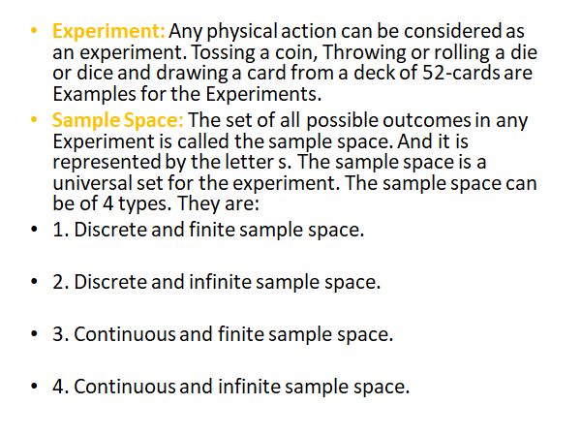

Slide 41
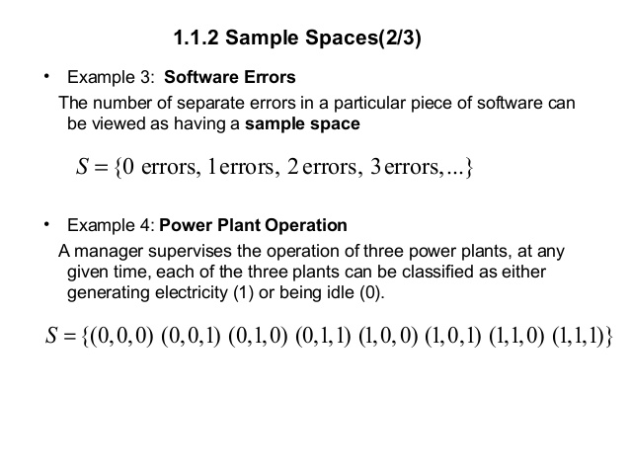

Slide 42
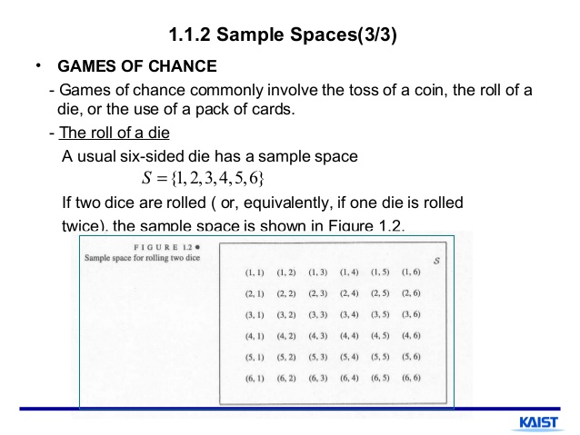

Slide 43
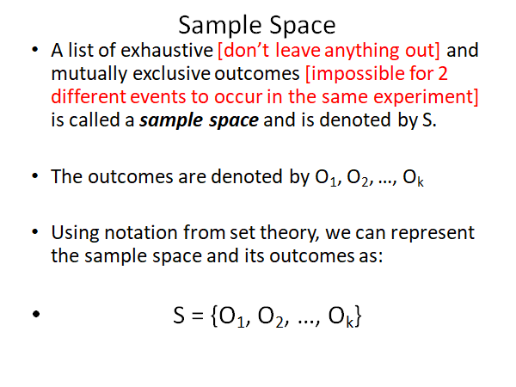

Slide 44
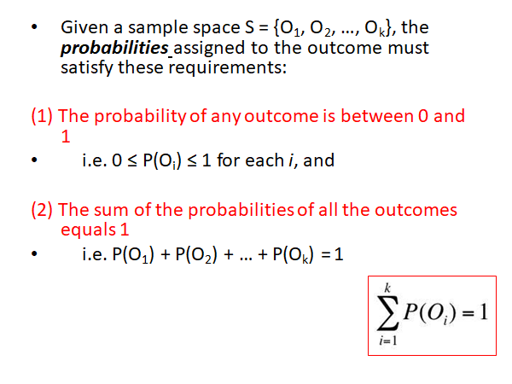

Slide 45
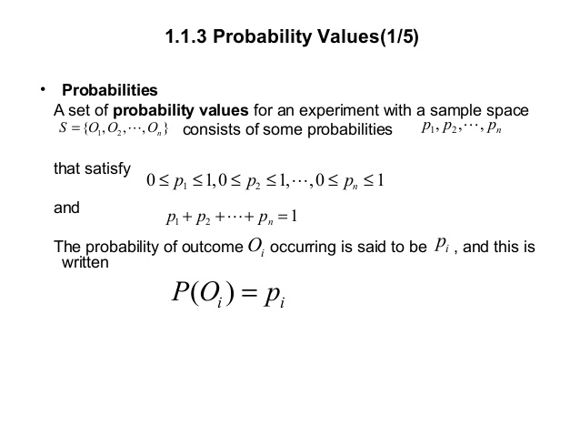

Slide 46
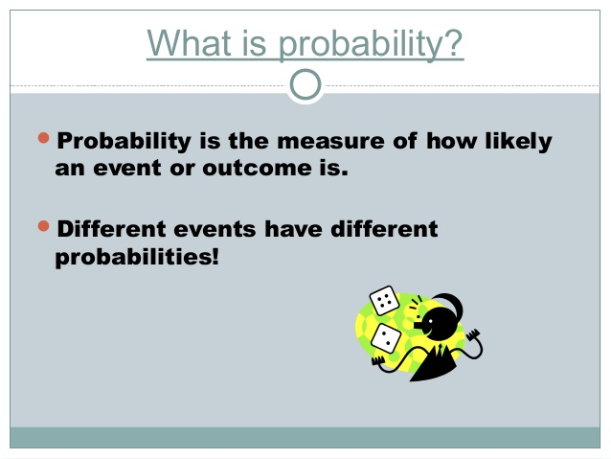

Slide 47
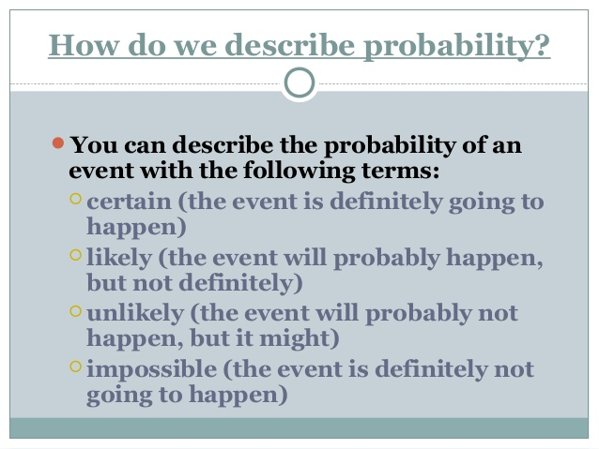

Slide 48
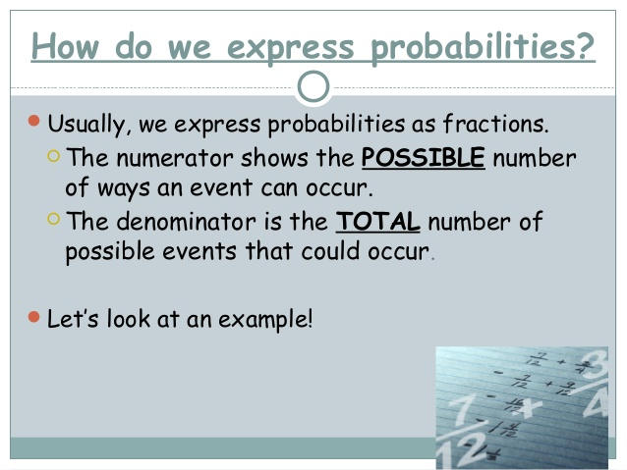

Slide 49
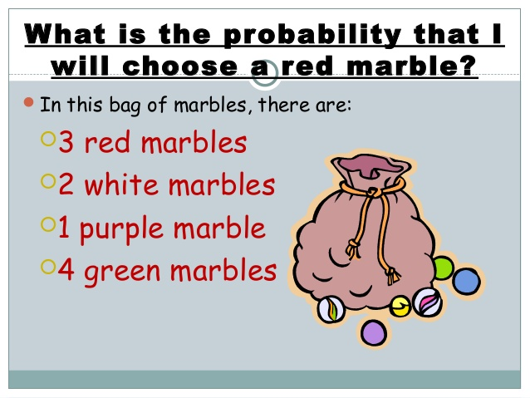

Slide 50
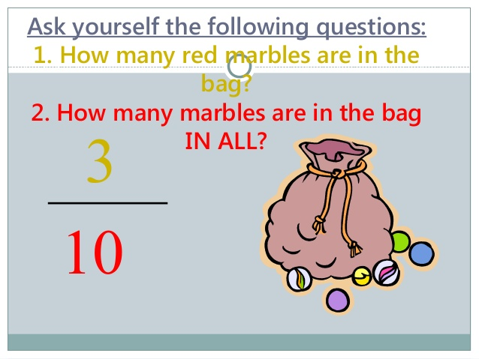

Slide 51
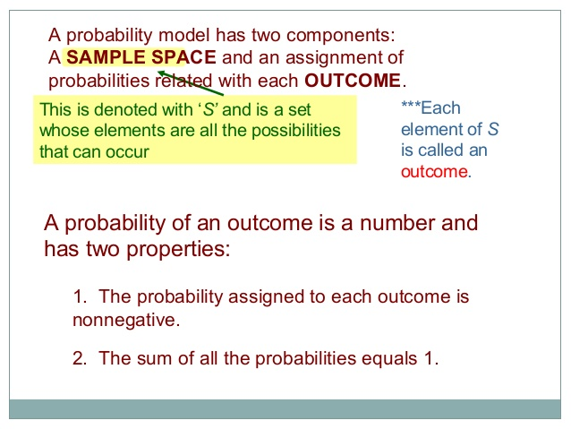

Slide 52
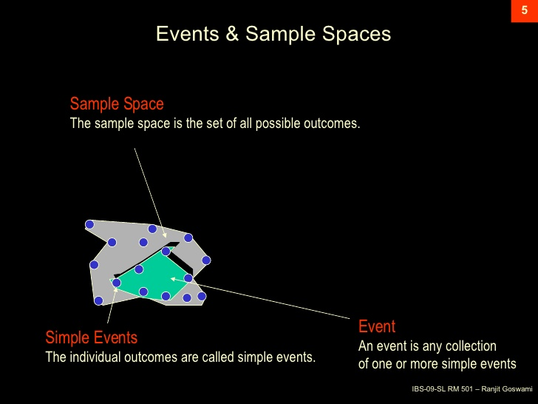

Slide 53
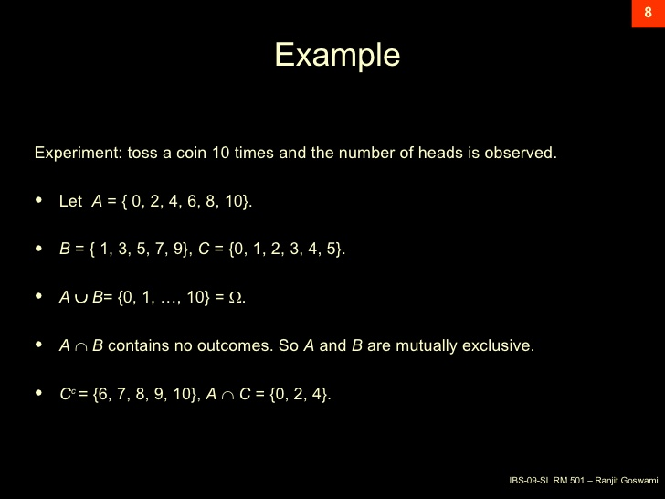

Slide 54
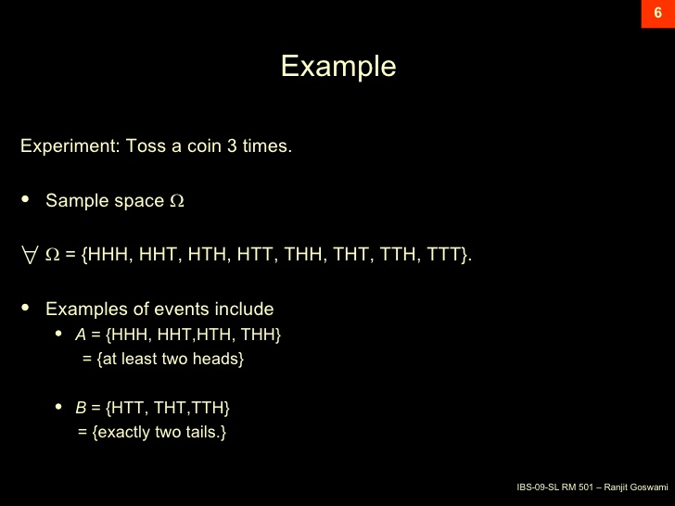

Slide 55
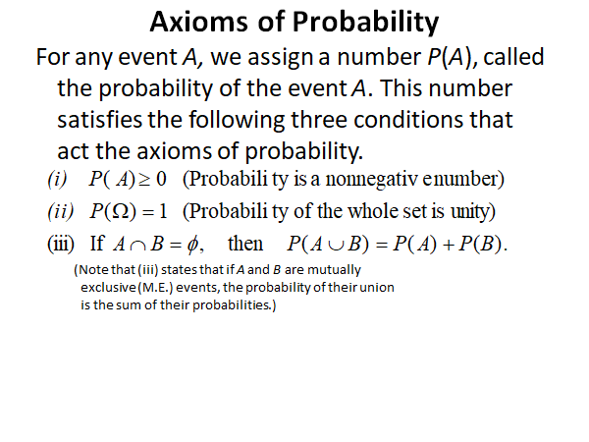

Slide 56
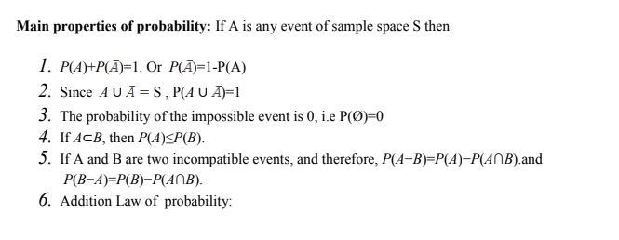


Slide 57
(1) S=AUA’ A ∩A’=Ø
from axiom (ii) P(S)=1
P(AUA’ )=P(A)+P(A’)---------from axiom(iii) here A and A’ are mutually exclusive events
ie)P(S)=P(AUA’ )=P(A)+P(A’)=1
P(A)= 1-P(A’)
From axiom(i)
P(A’)≥0 ie)P(A)≤1
0 ≤ P(A) ≤1
(2) S=SU Ø
S ∩ Ø= Ø
p(S)=1
P(SU Ø)= P(S)+P(Ø) from axiom(iii) ,here S and Ø are mutually exclusive events
1 =1+P(Ø)
P(Ø)=1-1 =0
Probability of null event is Zero also known as impossible event

Slide 58
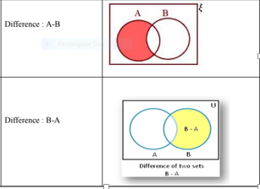
If A and B are two events
p(AUB)=P(A)+P(B)-P(A ∩B)
We know that A ∩B’, A ∩B, B ∩A’ are mutually exclusive events
P(AUB)=P(A ∩B’)+P(A ∩B)+P(B ∩A’ ) using axiom (iii)----(1)
We know that A=(A-B)+(A ∩B)=(A ∩B’)+(A ∩B)
P(A)=P(A ∩B’)+P(A ∩B)
P(A ∩B’)=P(A)-P(A ∩B)------(2)
Similarly P(B ∩A’)=P(B)-P(A ∩B)----(3)
Sub (2),(3) in (1)
P(AUB)=P(A)-P(A ∩B)+P(A ∩B)+P(B)-P(A ∩B)
Therefore P(AUB)=P(A)+P(B)-P(A ∩B)

Slide 59
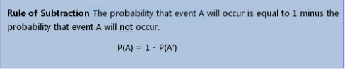
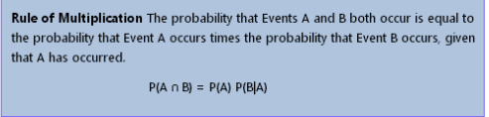
Rules of Probability
Rule of subtraction:
Rule of Multiplication:

Slide 60
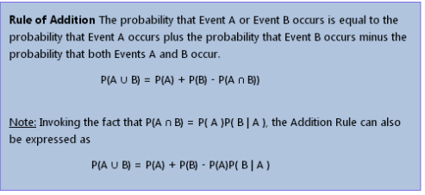
3.Rule of addition:

Slide 61
How to Interpret Probability
Mathematically, the probability that an event will occur is expressed as a number between 0 and 1.
Notationally, the probability of event A is represented by P (A).
▪ If P (A) equals zero, event A will almost definitely not occur.
▪ If P (A) is close to zero, there is only a small chance that event A will occur.
▪ If P (A) equals 0.5, there is a 50-50 chance that event A will occur.
▪ If P(A) is close to one, there is a strong chance that event A will occur.
▪ If P(A) equals one, event A will almost definitely occur.
In a statistical experiment, the sum of probabilities for all possible outcomes is equal to one.
This means, for example, that if an experiment can have three possible outcomes (A, B, and C),
then P(A) + P(B) + P(C) = 1.

Slide 62
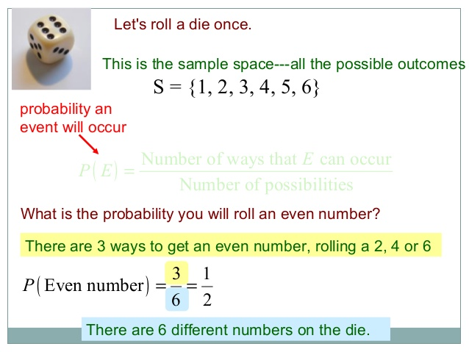

Slide 63
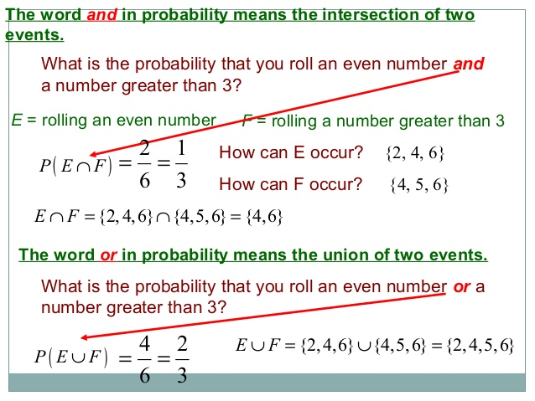

Slide 64
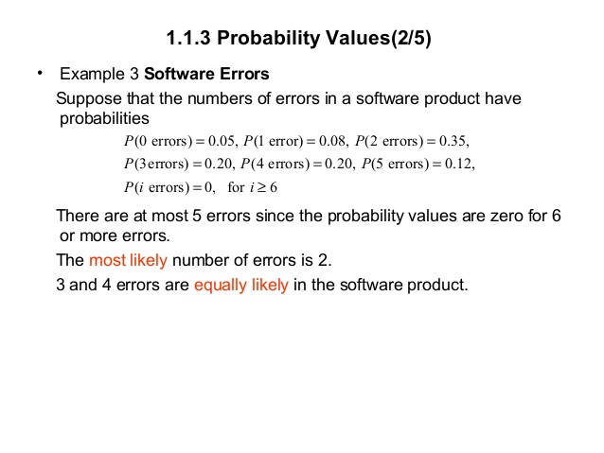

Slide 65
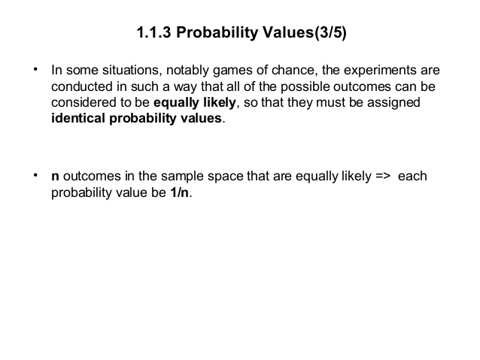

Slide 66
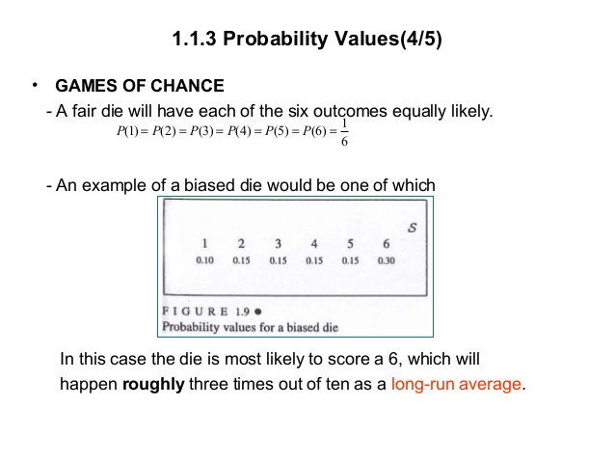

Slide 67
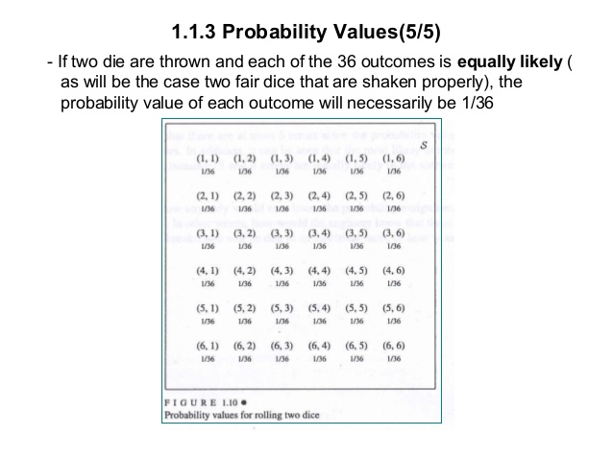

Slide 68
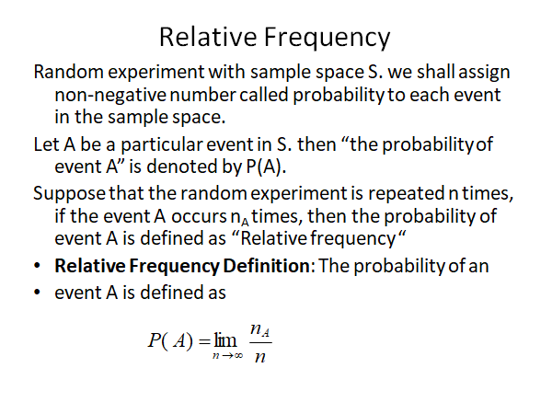

Slide 69
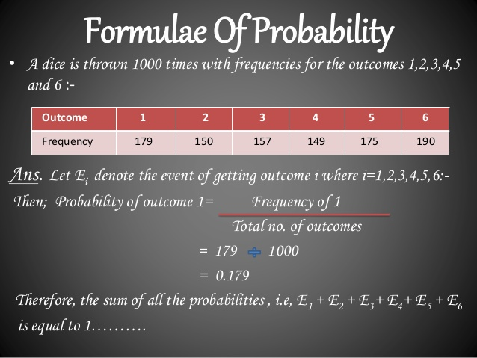

Slide 70
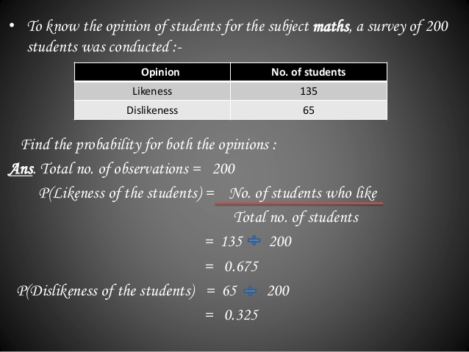

Slide 71
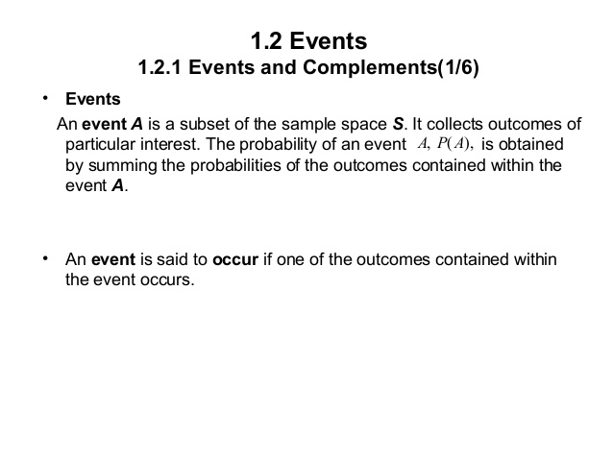

Slide 72
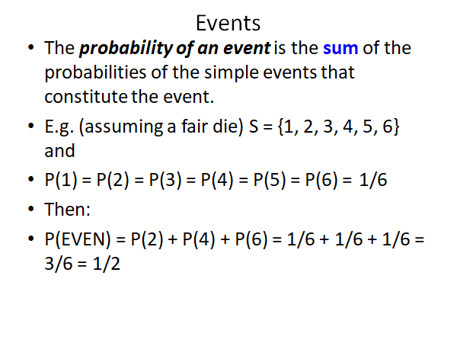

Slide 73
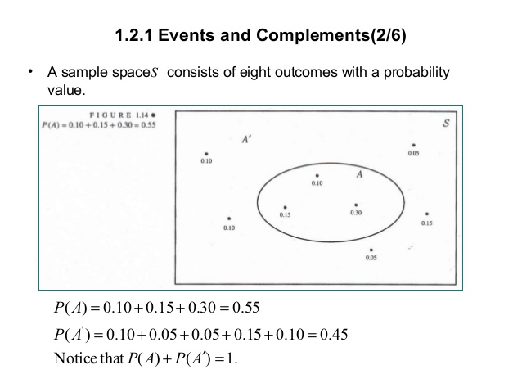

Slide 74
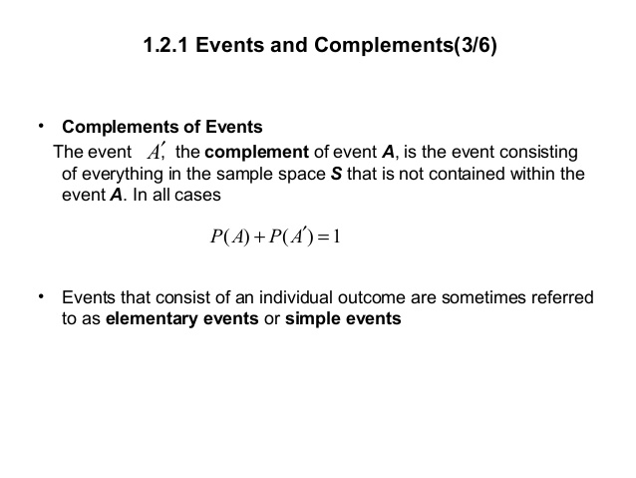

Slide 75
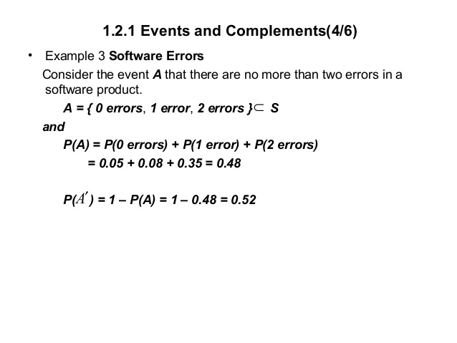

Slide 76
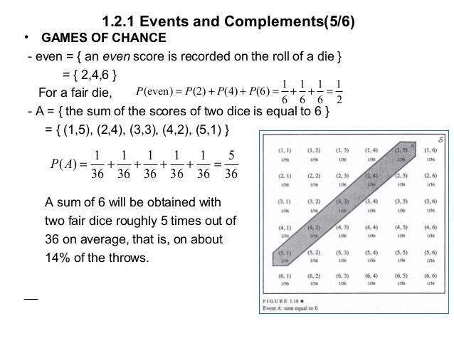

Slide 77


Slide 78
Types of Events:
1. Exhaustive Events:
A set of events is said to be exhaustive, if it includes all the possible events.
Ex. In tossing a coin, the outcome can be either Head or Tail and there is no other possible outcome. So, the set of events
{ H , T } is exhaustive.
2. Mutually Exclusive Events:
Two events, A and B are said to be mutually exclusive if they cannot occur together.
i.e. if the occurrence of one of the events precludes the occurrence of all others, then such a set of events is said to be mutually exclusive.
If two events are mutually exclusive then the probability of either occurring is
Ex. In tossing a coin, the coming of the head or the tail is equally likely.

Slide 79


3.Equally Likely Events: If one of the events cannot be expected to happen in preference to another, then such events are said to be Equally Likely Events.( Or) Each outcome of the random experiment has an equal chance of occuring.
Ex. In tossing a coin, the coming of the head or the tail is equally likely.
4. Independent Events:
Two events are said to be independent, if happening or failure of one does not affect the happening or failure of the other. Otherwise, the events are said to be dependent.
If two events, A and B are independent then the joint probability is
5.Non-. Mutually Exclusive Events:
If the events are not mutually exclusive then

Slide 80
Mathematical model of experiments:
Assignment of sample space
Definition of events of interest
Making probability assignments to the events such that the axioms are satisfied.

Slide 81


Slide 82



Slide 83

•Joint Probability: If a sample space consists of two events A and B which are not mutually exclusive, and then the probability of these events occurring jointly or simultaneously is called the Joint Probability.
In other words the joint probability of events A and B is equal to the relative frequency of the joint occurrence. If the experiment repeats n number of times and the joint occurrence of events A and B is n(AB) times, then the joint probability of events A and B is

Slide 84



Slide 85

where the occurrence of one event affects the happening of the following event. These cases of probability are known as conditional probability.
The probability of occurrence of any event A when another event B in relation to A has already occurred is known as conditional probability. It is depicted by P(A|B).
As depicted by above diagram, sample space is given by S and there are two events A and B. In a situation where event B has already occurred, then our sample space S naturally gets reduced to B because now the chances of occurrence of an event will lie inside B.
As we have to figure out the chances of occurrence of event A, only portion common to both A and B is enough to represent the probability of occurrence of A, when B has already occurred. Common portion of the events is depicted by the intersection of both the events A and B i.e. A ∩ B.
This explains the concept of conditional probability problems i.e. occurrence of any event when another event in relation to has already occurred.

Slide 86
Conditional Probability Formula
Mathematically this can be represented as,
P(A|B) = N(A∩B)/N(B)
Where P(A|B) represents the probability of occurrence of A given B has occurred.
N(A ∩ B) is the number of elements common to both A and B.
N(B) is the number of elements in B and it cannot be equal to zero.
Let N represent the total number of elements in the sample space. P(A|B) = (N(A∩B)/N)/(N(B)/N)
Since N(A ∩ B)/N and N(B)/N
denotes the ratio of the number of favourable outcomes to the total number of utcomes,
therefore, it indicates the probability.
Therefore, N(A ∩ B)/N can be written as P(A ∩ B) and N(B)/N as P(B).
⇒ P(A|B) = P(A ∩ B)/P(B)
Similarly, the probability of occurrence of B when A has already occurred is given by,
P(B|A) = P(B ∩ A)/P(A)
Therefore, P(A ∩ B) = P(B) P(A|B) if P(B) ≠ 0
= P(A) P(B|A) if P(A) ≠ 0
P(A|B) = N(A∩B)/N(B)

Slide 87


Slide 88

Conditional Probability must satisfy the three axioms
By the definition P(A∩B) and P(B) are non negative numbers
Therefore, P(A/B) is also non negative number
ie) P(A/B) ≥ 0 -------(axiom 1)
Let A=S
P(S/B)= $\frac{\text{P}\text{(}\text{S}\text{∩}\text{B}\text{)}}{\text{P}\text{(}\text{B}\text{)}}$ = $\frac{\text{P}\text{(}\text{B}\text{)}}{\text{P}\text{(}\text{B}\text{)}}$ = 1 ------(axiom 2)
So both axiom 1 and axiom 2 satisfied for conditional probability

Slide 89


Slide 90

P(B/A)=1 P(B/A)=0 P(B/A)=P(A ∩B)/P(A)
0<P(A/B)≤1 P(A/B)=0 P(A/B)=P(A ∩B)/P(B)

